Slide 1

Jointless Track Circuits for Broken Rail Detection
With Stand-Alone PTC and CBTC Systems
Dr. Edwin R. Kraft

Slide 2
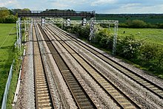
Agenda
Background
Concepts
Original Design Concept
Electrical Flows
Pre Shunt Problem
Alternative Design Concepts
Detectors
Rail Mounted Detector Concepts
Detectors Locations
Shunting Curves and Thresholds
Alternative Uses
Mathematical Calculations
Conclusions

Slide 3
Background
Observation:
Stand alone PTC and CBTC systems utilize precise train positioning data that is sourced independently of track circuits
Research Goal:
Develop a low cost, non intrusive track circuiting approach that could function as a broken rail detector to augment the capabilities of stand alone PTC and CBTC
Collateral Discovery:
With the addition of new type of rail-mounted current detector, jointless track circuits could be capable of reliably detecting shunts as well!

Slide 4
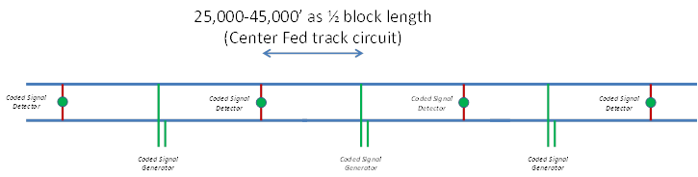
Original Design Concept for a Broken Rail Detector
Each generator produces a unique pulse code
Each receiver listens for the codes on each side
Each receiver reports codes it hears to the responsible PTC or CBTC server, where the safety logic resides

Slide 5
Electrical Flows in the Unshunted Broken Rail Detector
(For Wet Ballast and 0.25 Ω crossbond resistance. The electrical model will be described later in this presentation)

Slide 6
Pre- Shunt Problem
Rail
Crossbond
Coded Signal Detector
Coded Signal Detector
Crossbond
Rail
Coded Signal Generator
As a train approaches the detector, current will start flowing through the train wheels (shunt) instead of through the detector reducing current in the detector.
If Detector current falls below threshold before the train enters the block, a false “occupied block” or “broken rail” message could be issued.
equivalent of throwing a red signal in the face of the train.
In a PTC context it could trigger an unnecessary enforcement action.

Slide 7
Alternative Design Concepts
1
Train-Mounted Detectors
2
Detectors on Crossbonds
3
Rail-Mounted Detectors

Slide 8
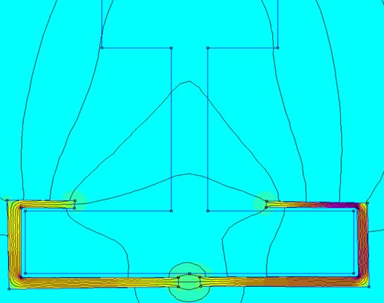
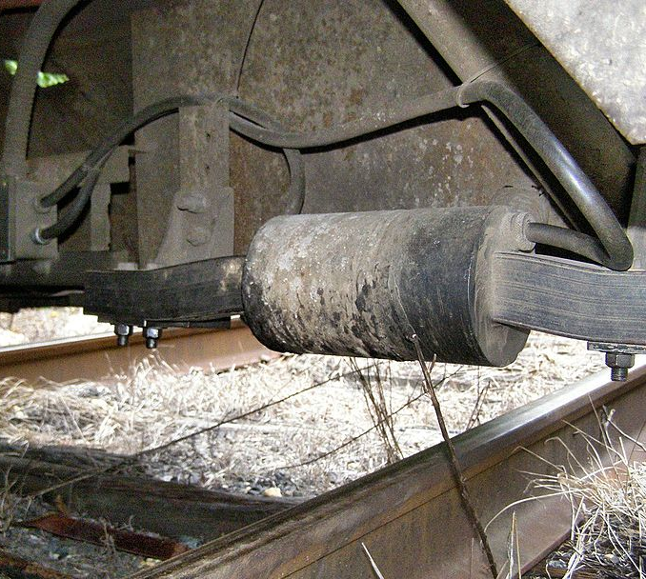
Rail-Mounted Detector Concepts
Hall-Effect Detector w/Concentrator*
For AC/DC Track Circuits in non-Electrified Territory
* Detector concept courtesy of Melexis, Inc.
Antenna for Inductive Pick-Up**
Of AC Track Circuits in Electrified Territory
** Photo source: https://en.wikipedia.org/wiki/Pulse_code_cab_signaling licensed under the Creative Commons Attribution-Share Alike 3.0 License

Slide 9
Detector Locations
At a cross bond only two detectors are needed to have a full picture of the current flows at that location
Detectors can not be symmetrically located across both rails on the same side of the cross bond
With any two of the measurements, the third can be derived by adding or subtracting
provides redundancy in the system, in case one of the detectors should fail
3.92 A
6.63 A
Crossbond
2.71 A
3.92 A
6.63 A
OK √
OK √
OK √
OK √

Slide 10
Detectors are on Both Sides of a Center Feed
Rail
Crossbond
Coded Signal Detectors
Coded Signal Detectors
Crossbond
Rail
Left Side Detector
Right Side Detector
Coded Signal Generator
Train is approaching from the Left
This is the definition of the “left” and “right” side detector that is used in the shunting curve diagrams on the following pages.
The train is moving from left to right across the track circuit, as shown

Slide 11
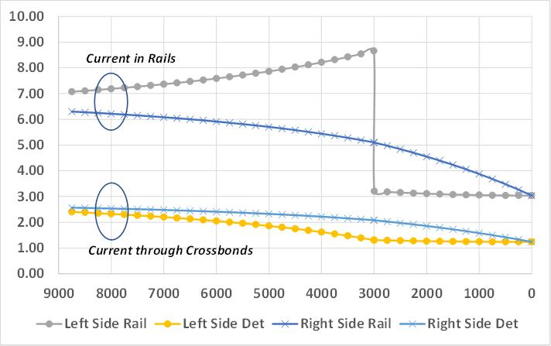
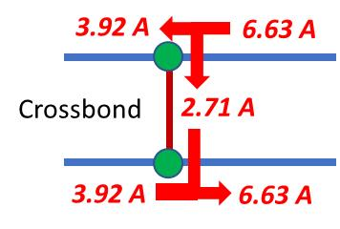
Shunting Curves (1/2)
For a 6,000 track circuit with Wet Ballast, a 0.06 Ω shunt and 0.25 Ω crossbond resistance
Rail current is asymptotic to the unshunted value of 6.63 A, and crossbond current to 2.71 A
Rail Mounted detectors show a sharp response the instant a train crosses over them -- even without insulated joints

Slide 12
Shunting Curves (2/2)
Wet Ballast, 0.06 Ω (Minimal) Shunt
Dry Ballast, 0.06 Ω (Minimal) Shunt
Cross Bond detectors are badly Pre-Shunted by a Heavy Shunt
cannot tell when the block has been entered
Rail Mounted Detectors are immune to Pre-Shunting
work better the stronger the shunt even without insulated joints!
might function effectively as replacements for conventional track circuits
Wet Ballast, 0.0006 Ω (Heavy) Shunt
Dry Ballast, 0.0006 Ω (Heavy) Shunt

Slide 13
Setting the Detector Thresholds
Conventionally based on 0.06 Ω shunt by comparing “wet ballast shunted” vs. “Dry ballast unshunted.”
Detector thresholds for the Jointless Track Circuit:
4.94 amps
73.74 amps/ Ω (normalized amp/feed Ω metric)

Slide 14
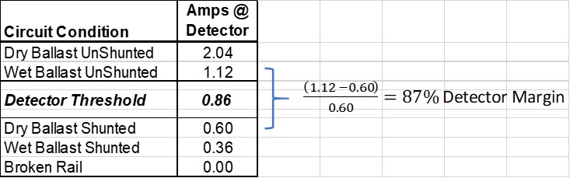
Amps per Ohm Normalization*
Introducing this feature provides, among other things the ability of a track circuit to adjust itself for wet/dry ballast conditions
In wet condition drops from 2.04 to 1.12 a; feed resistance similarly drops from 0.446 to 0.236 Ω
* This is for a “normal” track circuit with IJ’s as discussed in Examples 1 and 2

Slide 15
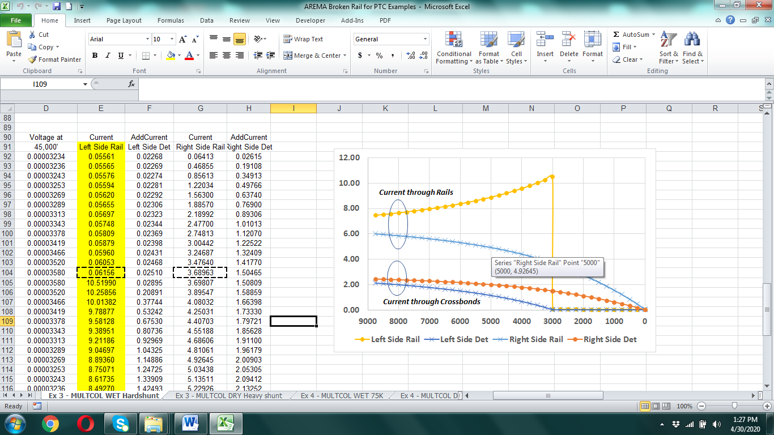
Preventing a Pre-Shunt of the Right Side Detector (1/2)
A heavy 0.0006 Ω shunt would reduce the current at the right side detector to 4.92 amps when the train is still 2,000’ left of the left side detector
This could pre-shunt the circuit 2,000’ early throwing a red signal in the face of the train.
Can be prevented by using the amps/ohm thresholds in addition to the amperage thresholds

Slide 16
Preventing a Pre-Shunt of the Right Side Detector (2/2)
The feed resistance of the track circuit vs. The current flowing through the un-shunted right side of the track circuit are linearly related.
Even as the current flowing to the right-side drops, the overall resistance of the track circuit reduces at exactly the same rate.
using the amps per ohm normalization in conjunction with the current readings, pre-shunting of the right-side detector can be prevented.
Amps per ohm normalization can be used to improve the shunting sensitivity of conventional track circuits as well.

Slide 17
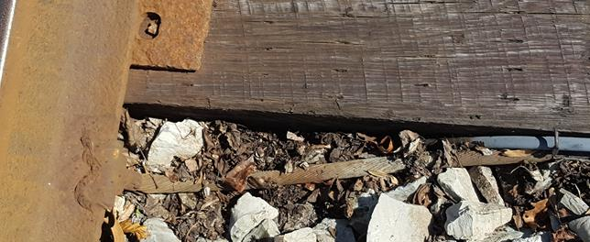
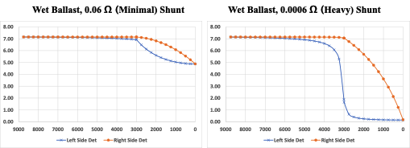
Alternative Uses
A Low-Cost Broken Rail Detector could be developed by mounting a Hall Effect device or Rogowski Coil on a very low-resistance crossbond.
This circuit would be unable to detect a shunt.
Any Pre-Shunting would only occur a short distance ahead of the crossbond, which could be accommodated by using a very low detection threshold and by adding a small buffer margin into the PTC or CBTC system safety algorithm.

Slide 18
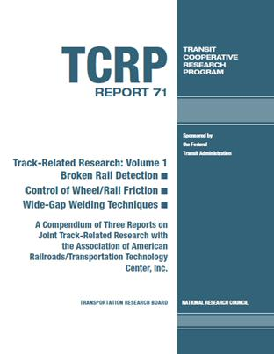
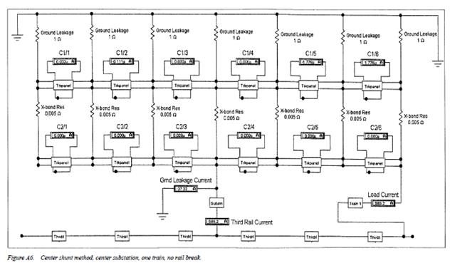
Additional Uses for Current Detectors
Current detectors on crossbonds and rails could also monitor and detect anomalies in traction current flows on electrified railroads including those caused by broken rails.
Reference 2001 TRB/TCRP Report 71 http://www.trb.org/Publications/Blurbs/153771.aspx

Slide 19
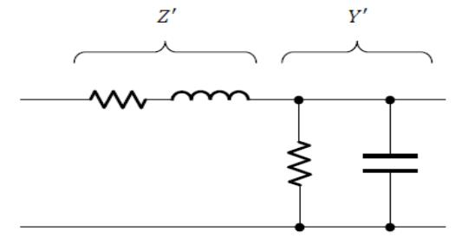
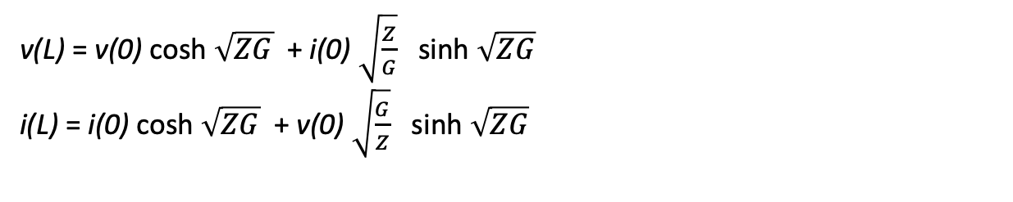
Mathematical Calculations (1/2)
The “transmission line” equations were used to calculate the results of this paper.
v(L) = v(0) cosh $\sqrt{ZG}$ + i(0) $\sqrt{\frac{Z}{G}}$ sinh $\sqrt{ZG}$
i(L) = i(0) cosh $\sqrt{ZG}$ + v(0) $\sqrt{\frac{G}{Z}}$ sinh $\sqrt{ZG}$
Reference: Landau, Stuart “Ballast Resistance Measurement—Theory and Practice”, presented at AREMA 2015 Annual Conference, Minneapolis, MN, October 4-7, 2015.

Slide 20

Mathematical Calculations (2/2)
A fully documented excel sheet detailing all the mathematical calculations of this paper is available for download at:
https://chipkraft.github.io/AREMA%20Broken%20Rail%20for%20PTC%20Examples.xlsx

Slide 21
Conclusions
The pre-shunt issue can be effectively addressed by mounting current detectors on the rails themselves, rather than on cross-bonds as current track circuit receivers
Cab signal systems rely on inductively picking up coded signals from the rails,
proves the technical feasibility of an ac rail-mounted current detector
Manufacturers of dc hall-effect sensing equipment have suggested the feasibility of developing a similar rail-mounted dc current detector as well.
Next steps include possible work on:
Detector development and testing
Electrical modeling of more complex track configurations and Jointless circuit types:
passing sidings and interlocking junctions
ac track circuits, including power frequency up to audio frequency track circuits

Slide 22
Thank You!

